Slide 1

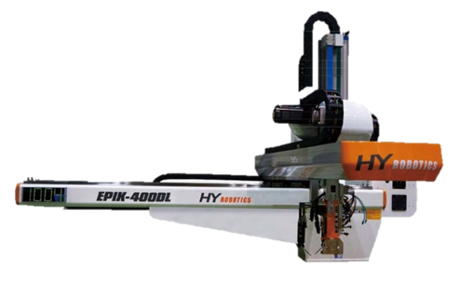

EPIK / UNIK
BASIC Training

Slide 2


z
Teaching Pendant
HYROBOTICS CORP
5319 Brown Ave.
St. Louis MO, 63120, USA
http://www.hyrobotics.com

Slide 3
Teaching Pendant
Emergency stop button
Main Screen button
Touch screen
Power and Error Indicator
Axis operation
Jog buttons
HYROBOTICS CORP
5319 Brown Ave.
St. Louis MO, 63120, USA
http://www.hyrobotics.com

Slide 4
Teaching Pendant
Automatic Operation
Stop
Step by Step Operation
Manual Operation
Robot Use / No Use
(This button controls Interlock signals)
Homing (goes to Wait position)
(Press & Hold)
Overall Velocity
HYROBOTICS CORP
5319 Brown Ave.
St. Louis MO, 63120, USA
http://www.hyrobotics.com

Slide 5
Status Bar

Slide 6







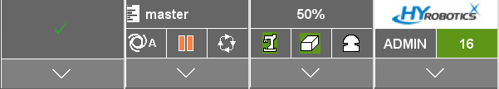
z
Status bar
Program execution state
Execution mode
Operation mode
On operation
Auto
Auto
Paused
Step
Stopped
Manual
You can modify programs
only in Manual mode.
HYROBOTICS CORP
5319 Brown Ave.
St. Louis MO, 63120, USA
http://www.hyrobotics.com

Slide 7
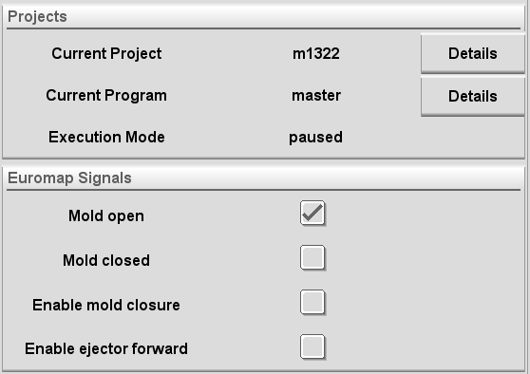
z
Status bar
Program execution state
Execution mode
Operation mode
On operation
Auto
Auto
Paused
Step
Manual
Stopped
You can change programs
only in Manual mode.
Current Mold file name
Current sub-program name.
“MASTER” must be loaded.
HYROBOTICS CORP
5319 Brown Ave.
St. Louis MO, 63120, USA
http://www.hyrobotics.com

Slide 8




z
Status bar
Robot Status
Operation Space / Reference
Referenced
Emergency Stop Button Status
Unreferenced
Robot In Use (No permission given to the machine)
Robot No Use (All permission given to the machine,
also the machine can be run by hand without the robot)

Slide 9
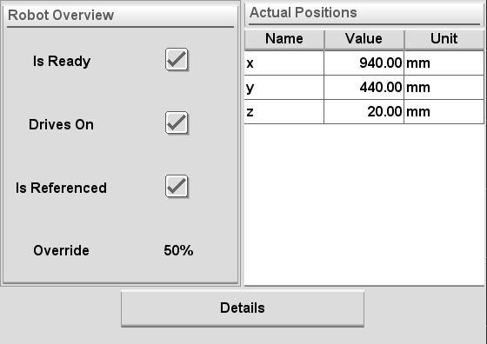
z
Status bar
Robot Status
Operation Space / Reference
Referenced
In Use (No IMM machine control)
Emergency Stop Button Status
Unreferenced
No Use (No robot control)
HYROBOTICS CORP
5319 Brown Ave.
St. Louis MO, 63120, USA
http://www.hyrobotics.com

Slide 10
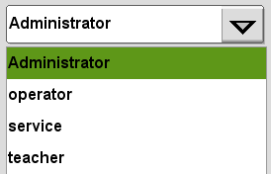
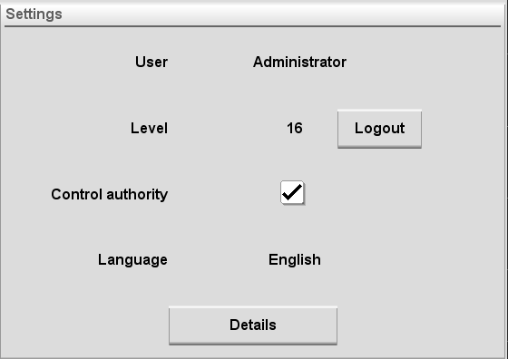
z
Status bar
Accessible areas in controller are differ by user level.
- Administrator (level 16) –allow to access entire systems in controller (PW: pass)
- Service (level 15) – allow to change the settings and edit the basic programs (PW: service)
- Teacher (level 7) – allow to access the basic settings and programs (PW: teacher)
- Operator (level 1) – only allow to control the robot operation in auto or manual (PW: operator)

Slide 11
Robot Speed
Auto
Robot In Use
(No permits to IMM)
or
or
Manual
Robot No Use
(No robot contol)

Slide 12
Main Screen

Slide 13
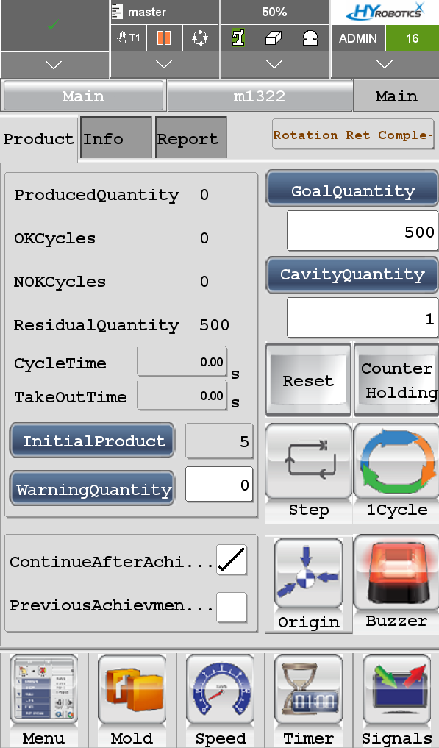
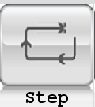



z
Main Screen
Product Tab
Shows production information
By turning on this option, robot will proceed whole dry cycle with a lower speed.
OFF
ON
By turning on this option, robot will only run for one cycle
then stop.
OFF
ON
Open Origin screen for referencing.
Detail will be shown later page.
HYROBOTICS CORP
5319 Brown Ave.
St. Louis MO, 63120, USA
http://www.hyrobotics.com

Slide 14
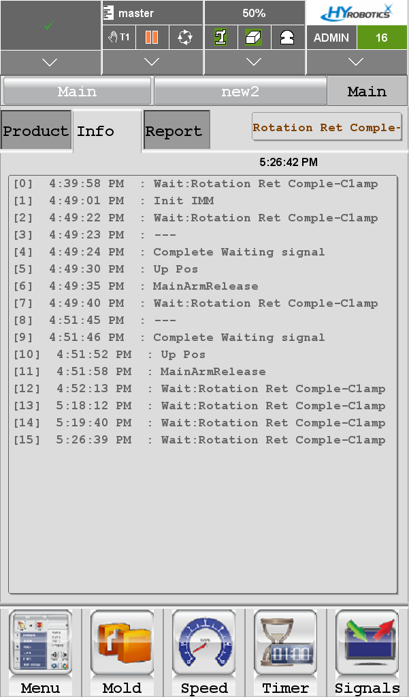
z
Main Screen
Info Tab
Shows current status of the robot
<Example>
WAIT: IMM
WAIT: Safety Door
WAIT: Rotation Complete
HYROBOTICS CORP
5319 Brown Ave.
St. Louis MO, 63120, USA
http://www.hyrobotics.com

Slide 15
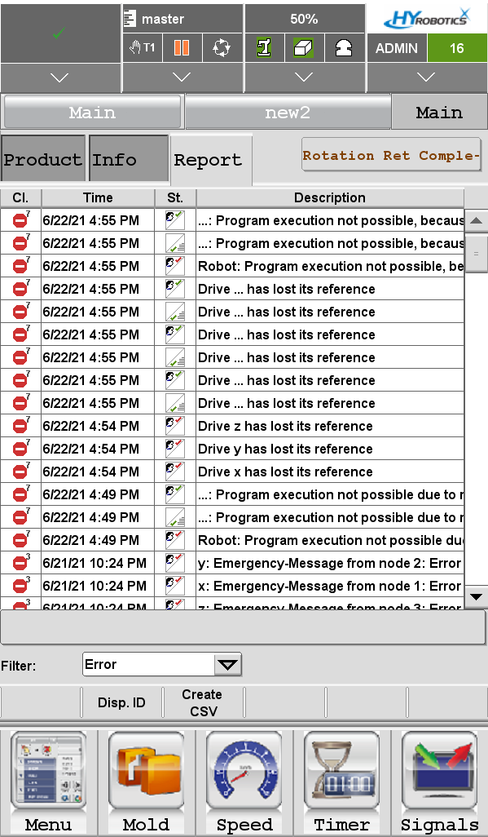
z
Main Screen
Report Tab
Shows warning & error message logs
HYROBOTICS CORP
5319 Brown Ave.
St. Louis MO, 63120, USA
http://www.hyrobotics.com

Slide 16
z
Main Screen
Main screen setting buttons
Menu: Go to other setting buttons
Mold : Mold file setting screen
Speed: Detail speed setting screen
Timer: Delay time setting screen
HYROBOTICS CORP
5319 Brown Ave.
St. Louis MO, 63120, USA
http://www.hyrobotics.com

Slide 17
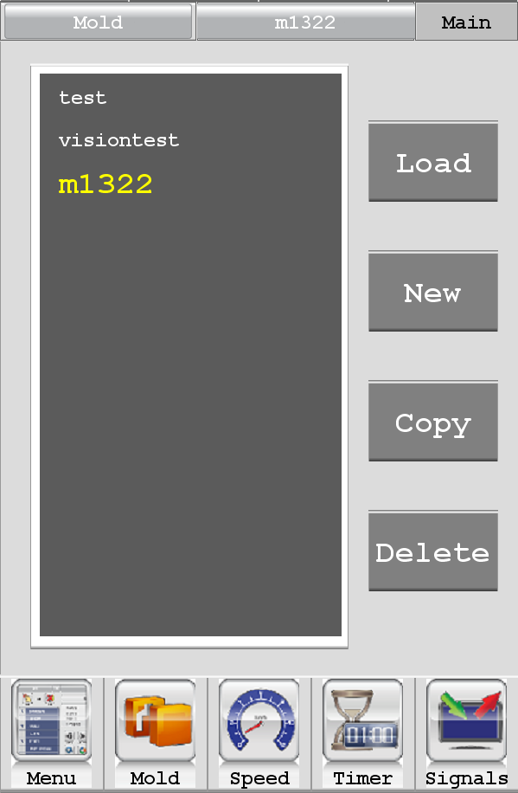
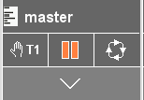
z
Menu - Mold
Load, create, copy, and delete the mold files
Yellow highlighted mold name = current loaded
*Changes are allowed only in manual operation state.
HYROBOTICS CORP
5319 Brown Ave.
St. Louis MO, 63120, USA
http://www.hyrobotics.com

Slide 18
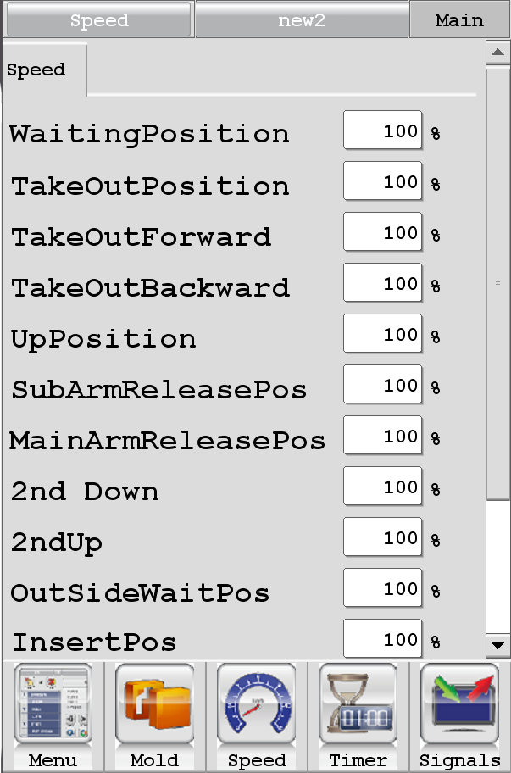
z
Menu - Speed
Adjust speed of each steps
③
①
②
HYROBOTICS CORP
5319 Brown Ave.
St. Louis MO, 63120, USA
http://www.hyrobotics.com
④

Slide 19
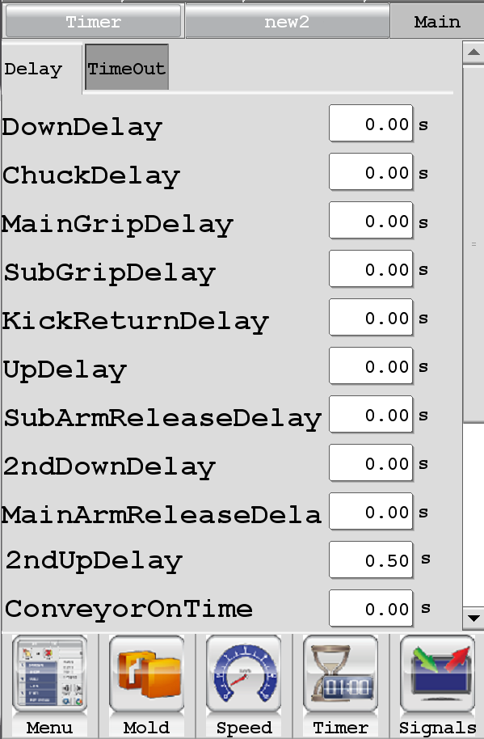
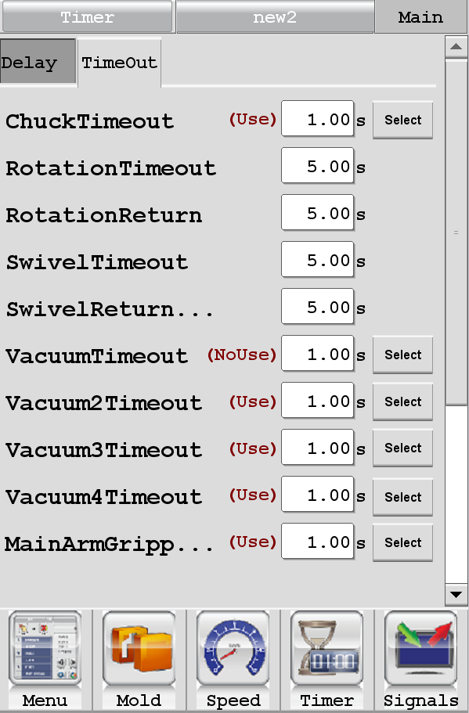
z
Menu - Timer
On/Off button
Adjust times for Method confirming signals
Adjust delay times
before a step.
HYROBOTICS CORP
5319 Brown Ave.
St. Louis MO, 63120, USA
http://www.hyrobotics.com
Notes:
The robot checks if the vacuum suction cup successfully grabbed the parts.

Slide 20
z
Menu - Timer
On/Off button
Adjust delay times
before a step.
Decide whether or not
to use the Vac. confirmation sensors or Gripper sensors.
HYROBOTICS CORP
5319 Brown Ave.
St. Louis MO, 63120, USA
http://www.hyrobotics.com
Notes:
The robot checks if the vacuum suction cup successfully grabbed the parts.

Slide 21
z
Main Screen
By pressing MENU button,
other setting buttons show up
HYROBOTICS CORP
5319 Brown Ave.
St. Louis MO, 63120, USA
http://www.hyrobotics.com

Slide 22
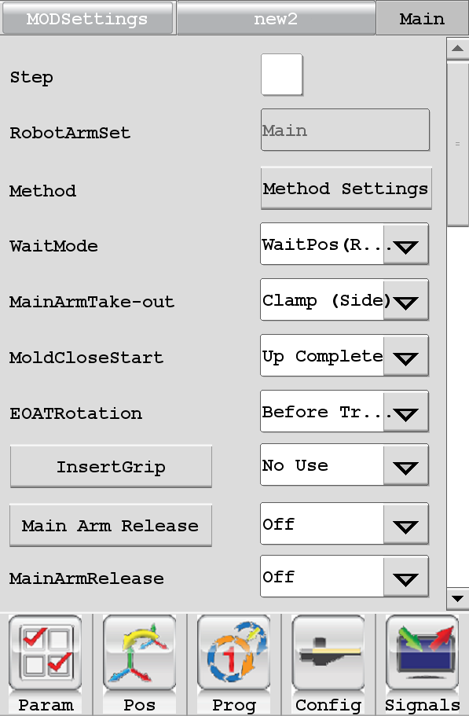
z
Main Screen
Parameters: Mode setting screen
Pos: Position setting screen
Prog: line-by-line program screen
HYROBOTICS CORP
5319 Brown Ave.
St. Louis MO, 63120, USA
http://www.hyrobotics.com

Slide 23
Teaching Positions

Slide 24
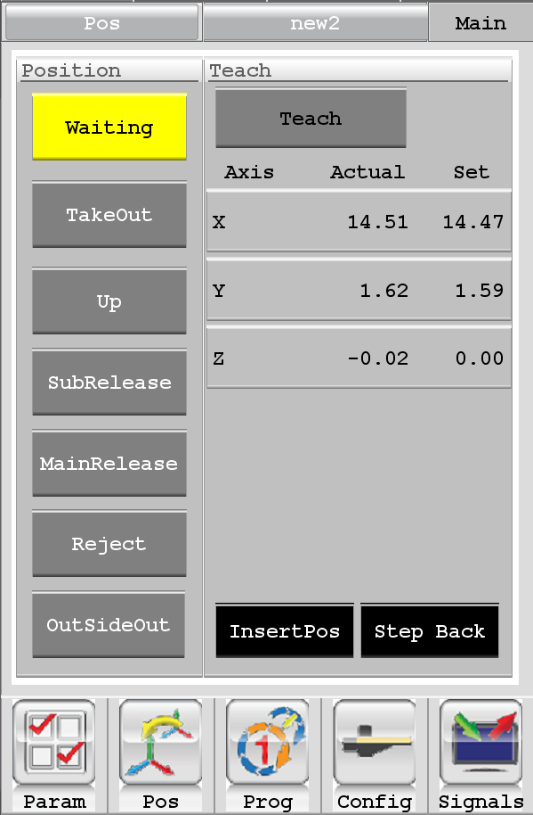
z
Menu - Position

Slide 25
z
Menu - Position
Select the position you want to teach

Slide 26

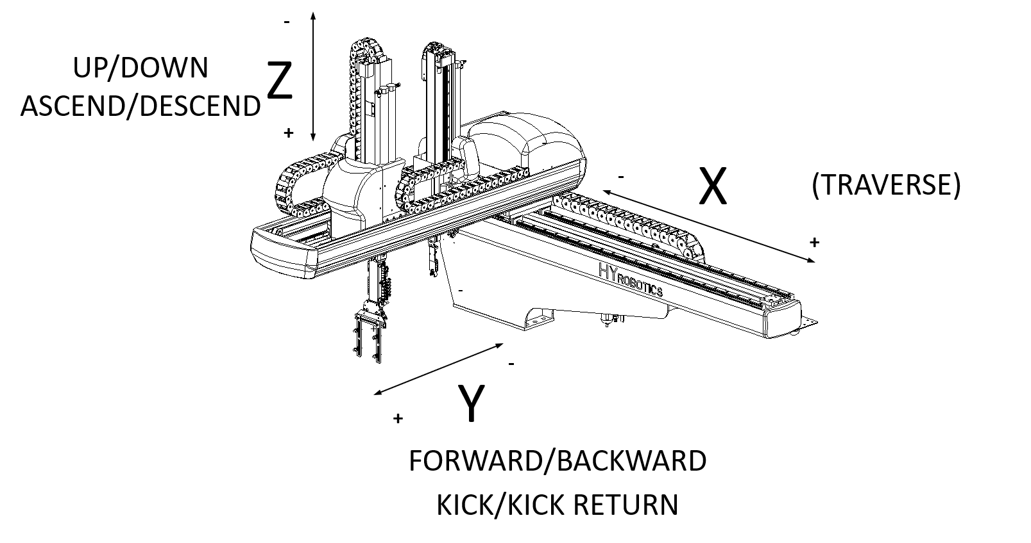
z
Menu - Position
1. Move the robot manually.
2. Press

Slide 27
z
Robot Action
③
①
②
  ① Waiting position (=Home position)
  ② Takeout position
  ③ Up position
  ④ Main Release position
④
HYROBOTICS CORP
5319 Brown Ave.
St. Louis MO, 63120, USA
http://www.hyrobotics.com

Slide 28
z
Menu - Position
Waiting position
(= Home position)
Position of waiting for the mold opening.
Robot moves to this position:
1. After referencing.
2. When homing button is pressed & held

Slide 29
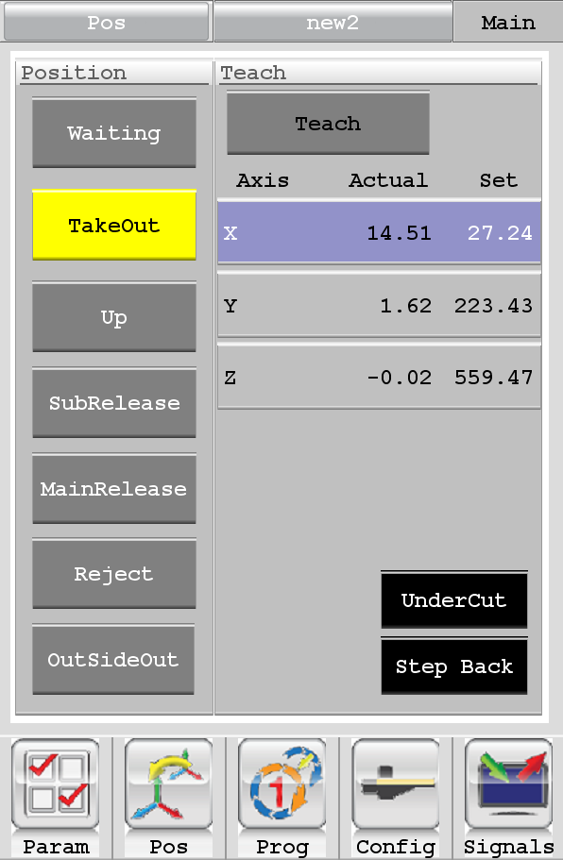
z
Menu - Position
Takeout position
HYROBOTICS CORP
5319 Brown Ave.
St. Louis MO, 63120, USA
http://www.hyrobotics.com

Slide 30
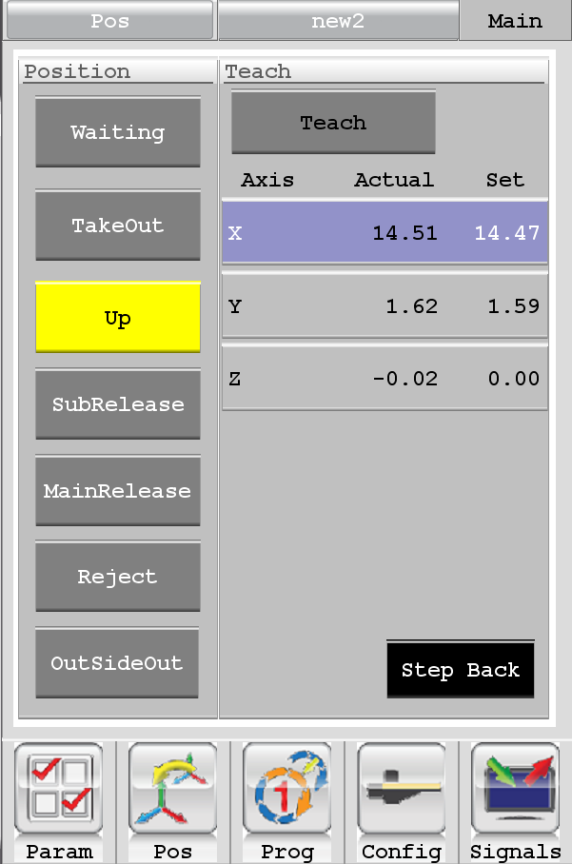
z
Menu - Position
Up position
Up position
Position of moving up after taking out.
Check “Vacuum Confirmation” at this position.

Slide 31
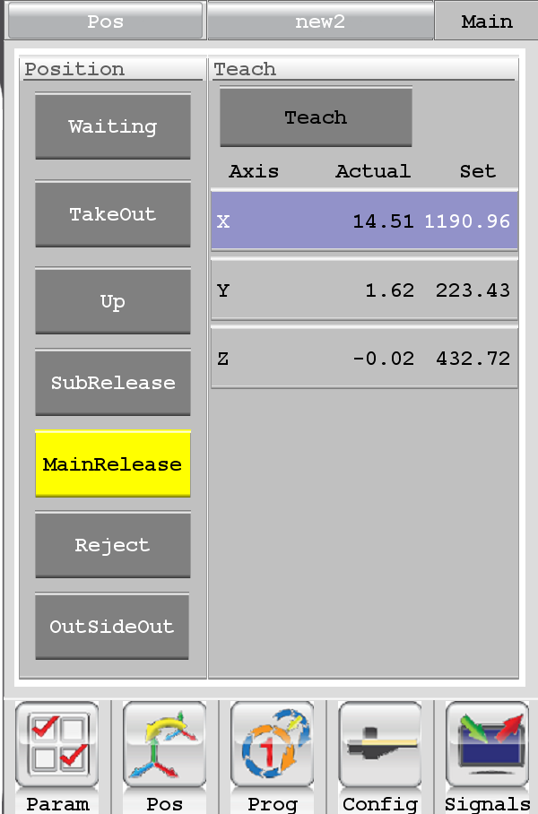
z
Menu - Position
Main Release position
Release position
Product
Conveyor
Position of releasing the product. (vacuum, chuck, or gripper)
If stacking or palletizing,
this position will be the 1st releasing position.

Slide 32
z
Menu - Position
The easiest teaching sequence of Four(4) basic positions
Teach Takeout position first
②
③
Teach Up & Waiting position
①
Teach Main Release position
④
HYROBOTICS CORP
5319 Brown Ave.
St. Louis MO, 63120, USA
http://www.hyrobotics.com

Slide 33
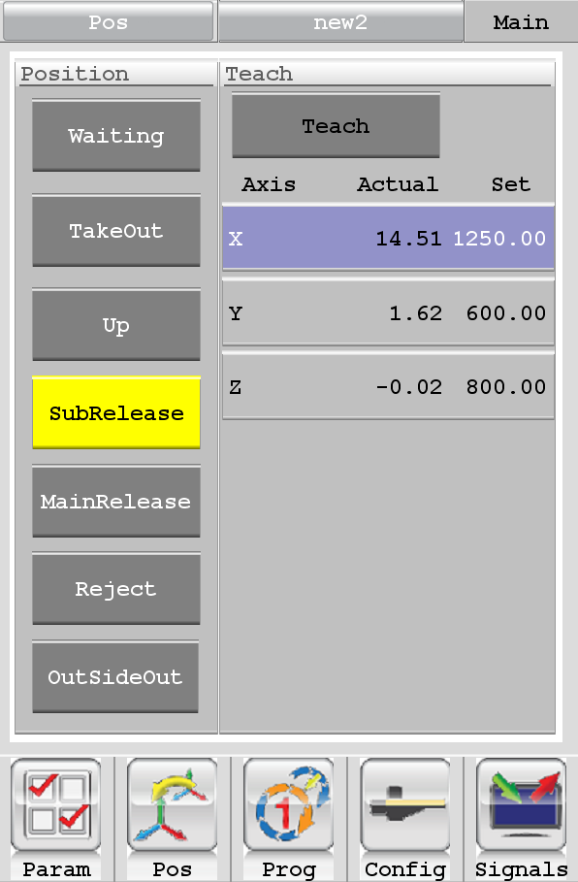
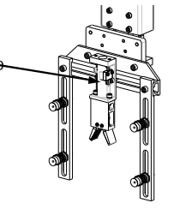
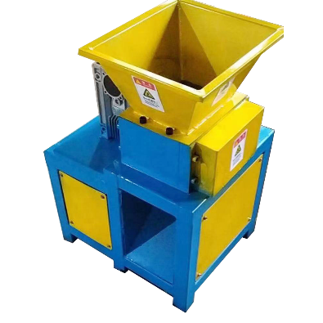
z
Menu - Position
③
①
  Separate Sprue runner and part(s)
  (Use Main Gripper for Sprue picking)
②
④
HYROBOTICS CORP
5319 Brown Ave.
St. Louis MO, 63120, USA
http://www.hyrobotics.com

Slide 34
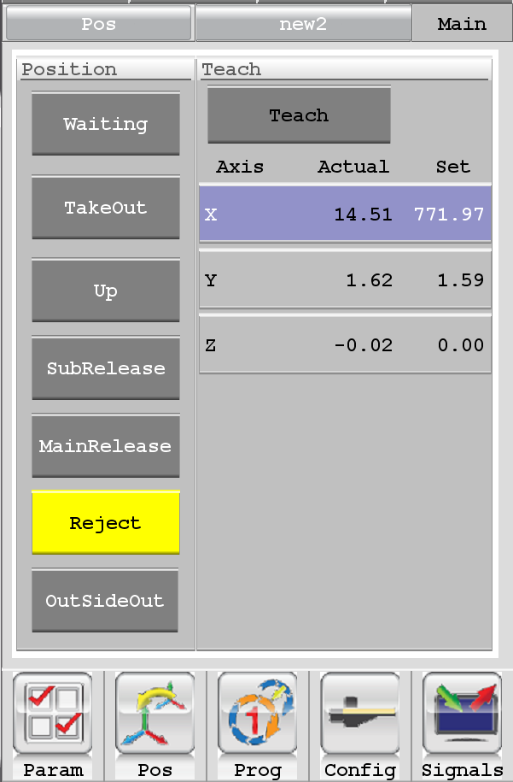

z
Menu - Position
Reject position
Position of releasing the rejected product or the initial products.
③
(this position can be the same as “Sub-Release Position”
①
  Reject
②
④

Slide 35
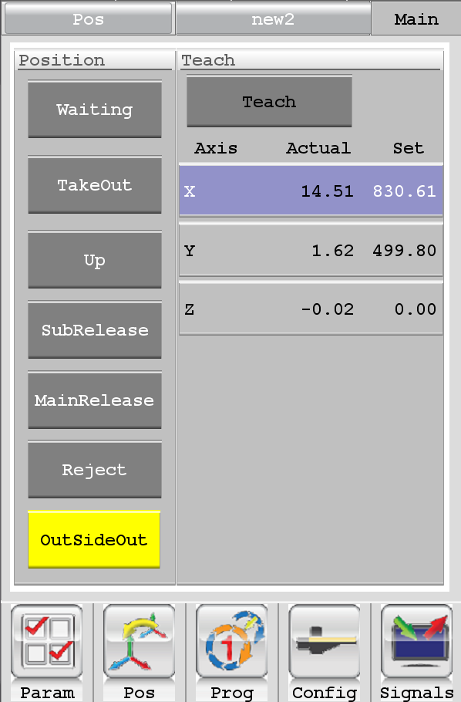
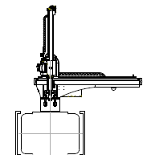
z
Menu - Position
Outside Wait position
Normal Wait position
Waiting on the mold to be opened in
the outside of machine area
HYROBOTICS CORP
5319 Brown Ave.
St. Louis MO, 63120, USA
http://www.hyrobotics.com

Slide 36
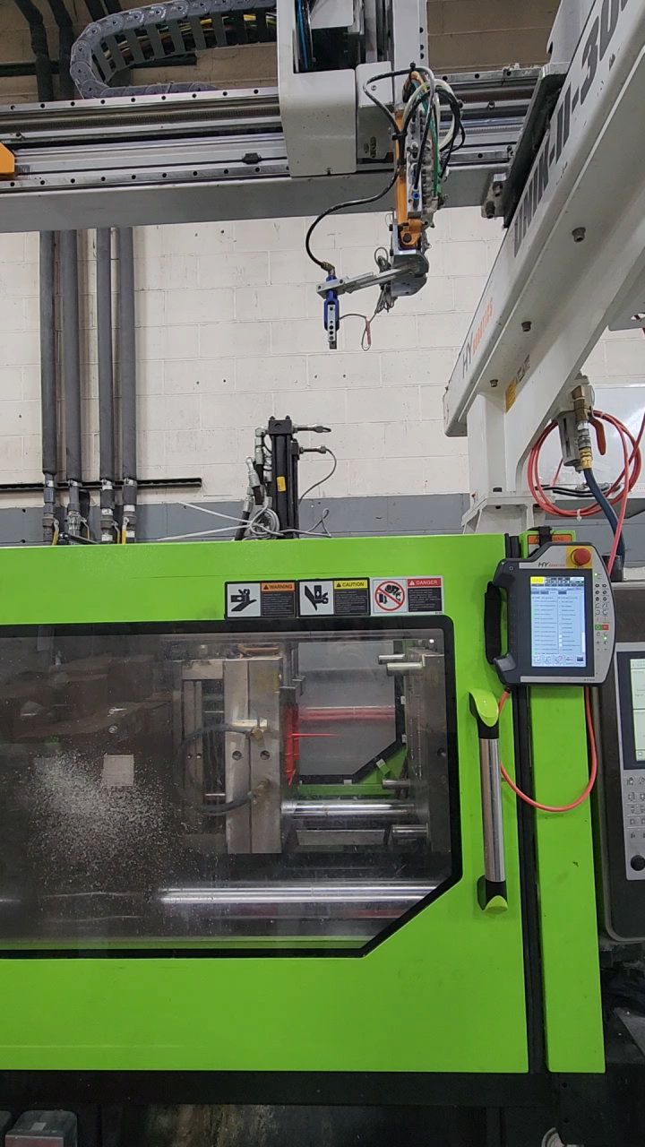
z
Menu - Position
Outside Wait position
Normal Wait position
Position of waiting or the mold to be opened in
a section outside the traversing mold
HYROBOTICS CORP
5319 Brown Ave.
St. Louis MO, 63120, USA
http://www.hyrobotics.com

Slide 37
z
Menu - Position
Outside Wait position
Pre-Waiting Position
Outside Wait
|
① Wait
|
② Takeout
|
③ Up
|
④ Release
③
①
②
④
HYROBOTICS CORP
5319 Brown Ave.
St. Louis MO, 63120, USA
http://www.hyrobotics.com

Slide 38
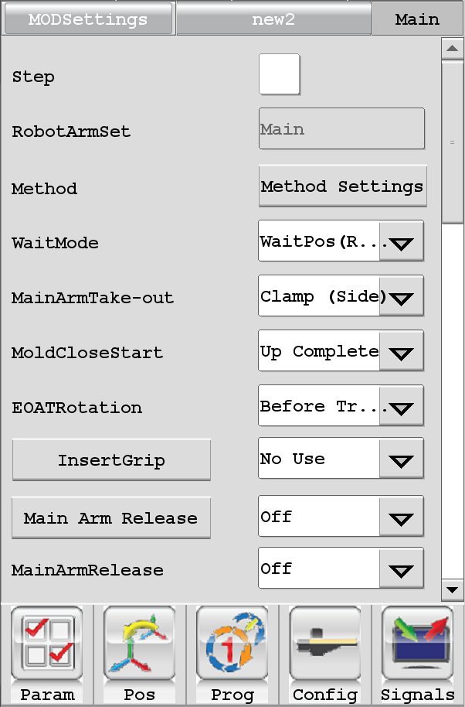
z
Menu - Parameter
Parameter Setting Screen
All the actions of the robot are set
in this screen.
Changes are allowed only in manual state.
HYROBOTICS CORP
5319 Brown Ave.
St. Louis MO, 63120, USA
http://www.hyrobotics.com

Slide 39
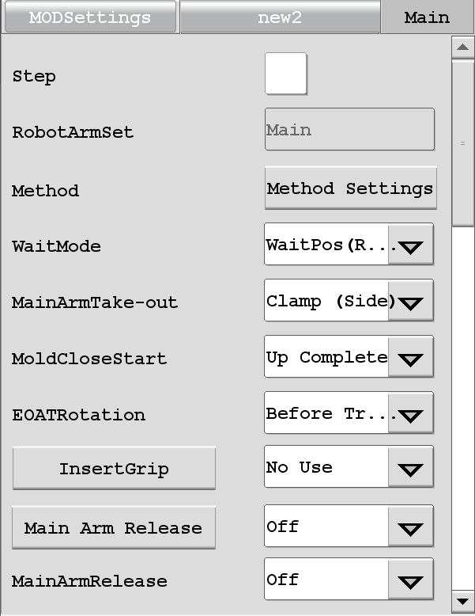
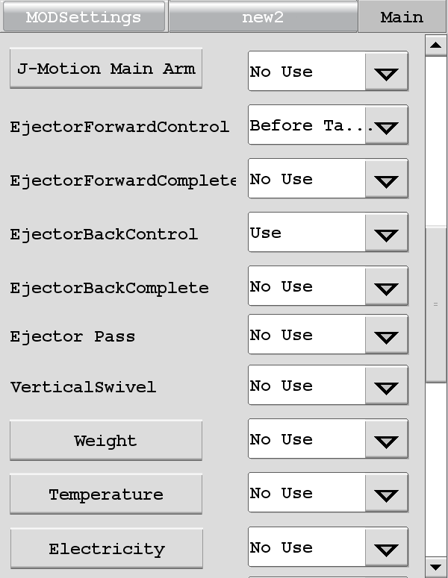
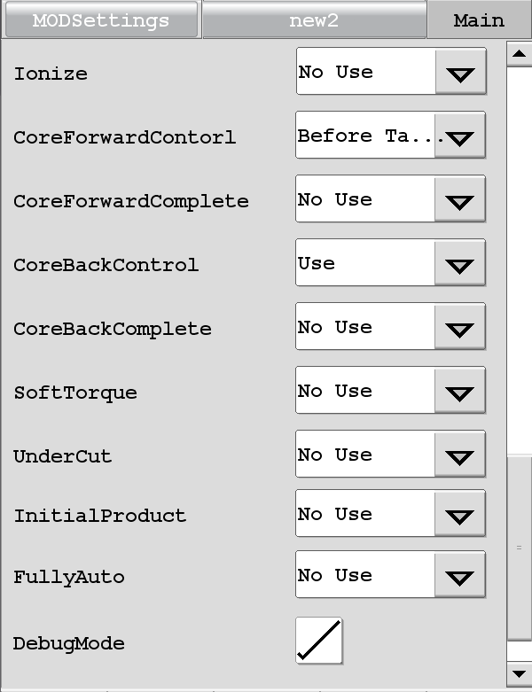
z
Menu - Parameter

Slide 40
z
Menu - Parameter

Slide 41
z
Menu - Parameter
Press here

Slide 42
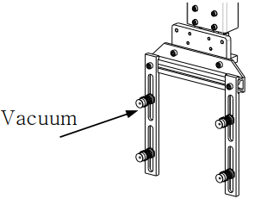
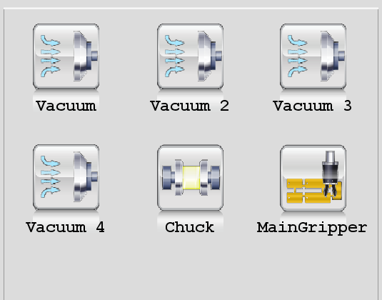
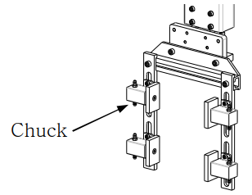
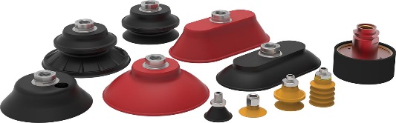
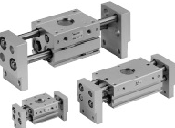
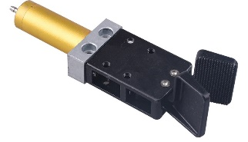
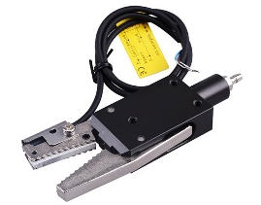
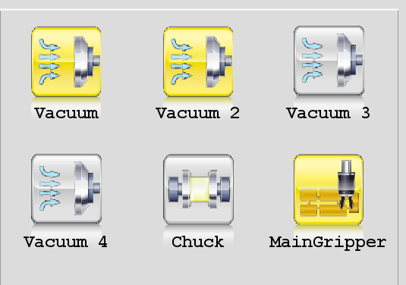
Select what method to use
Gripper
<example>

Slide 43
z
Menu - Parameter
If Debug Mode is marked, administrator can view the entire program while robot is running

Slide 44
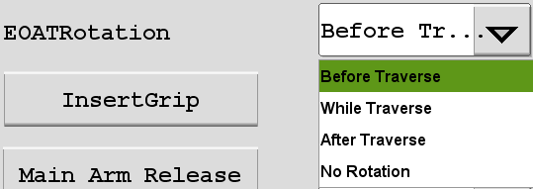

Set when to rotate EOAT
TRAVERSE MOVE

Slide 45
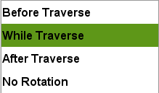
Set when to rotate EOAT
TRAVERSE MOVE

Slide 46
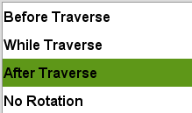
Set when to rotate EOAT
TRAVERSE MOVE

Slide 47
z
Menu - Parameter
If Debug Mode is marked, administrator can view the entire program while robot is running

Slide 48

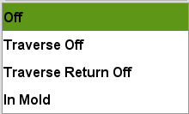
z
Setting runner release timing
③
①
  OFF setting:
  Not using sub release position for runner.
  All methods OFF at main release position
②
④
HYROBOTICS CORP
5319 Brown Ave.
St. Louis MO, 63120, USA
http://www.hyrobotics.com

Slide 49
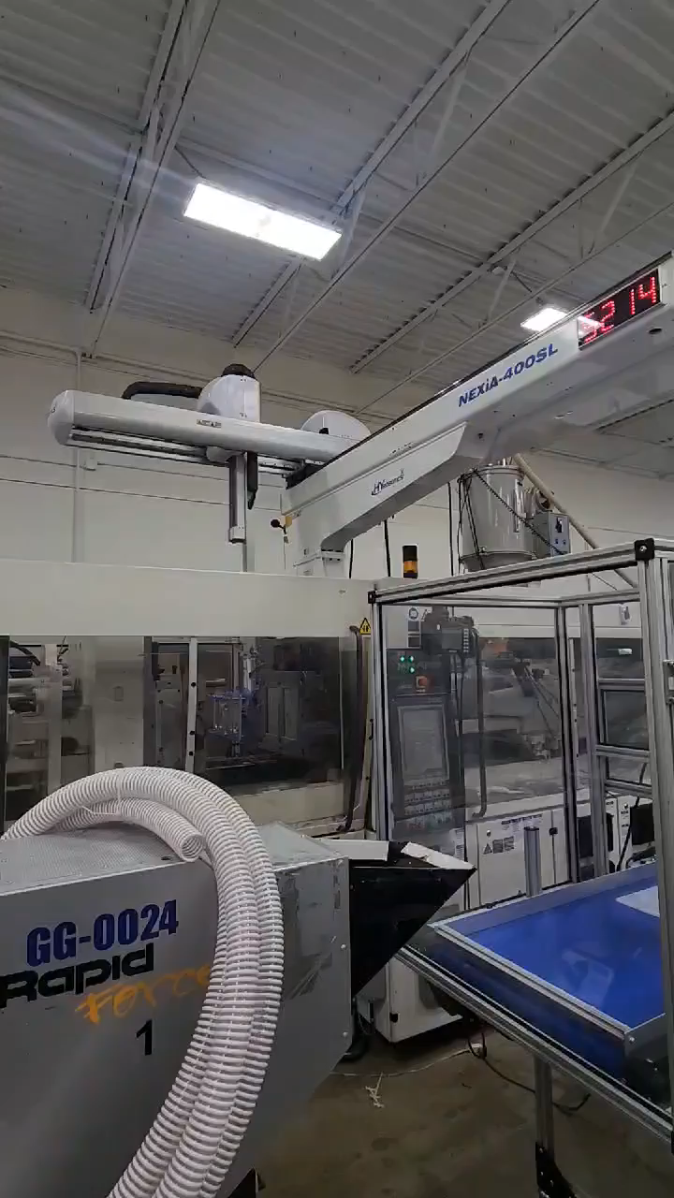
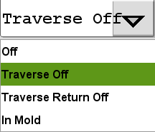
z
Setting runner release timing
③
Traverse OFF Setting
Drop the Runner(s) First
Then the part(s).
①
TRAVERSE MOVE
②
④
HYROBOTICS CORP
5319 Brown Ave.
St. Louis MO, 63120, USA
http://www.hyrobotics.com

Slide 50
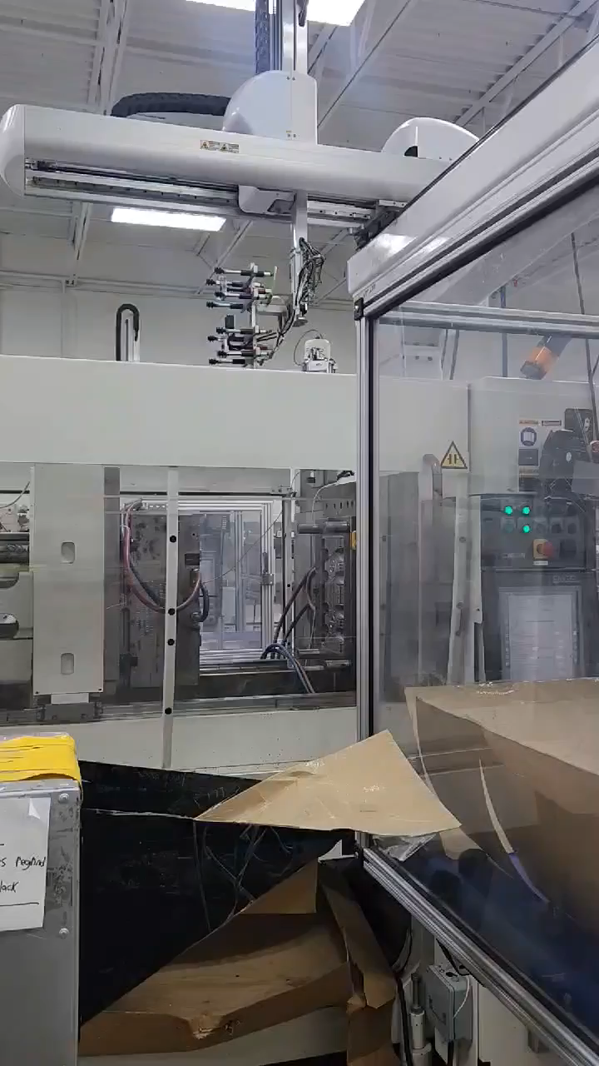
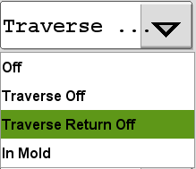
z
Setting runner release timing
③
①
Traverse Return OFF Setting
Drop the part(s) first
Then, drop the runner(s) while returning to WAIT position.
TRAVERSE RETURN MOVE
②
④
HYROBOTICS CORP
5319 Brown Ave.
St. Louis MO, 63120, USA
http://www.hyrobotics.com

Slide 51
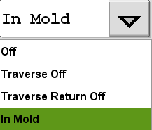
z
Setting runner release timing
③
①
In Mold Setting
After taking out the part & runner,
Kick back,
then release gripper,
then moves up.
②
④
HYROBOTICS CORP
5319 Brown Ave.
St. Louis MO, 63120, USA
http://www.hyrobotics.com

Slide 52
z
Menu - Parameter
If Debug Mode is marked, administrator can view the entire program while robot is running

Slide 53

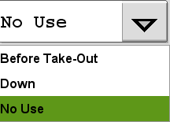
z
Controls Ejector Forward Timing
No Use Setting
Machine controls ejector forward timing
HYROBOTICS CORP
5319 Brown Ave.
St. Louis MO, 63120, USA
http://www.hyrobotics.com

Slide 54


z
Controls Ejector Forward Timing
Before Take-Out
The robot arrives at take out position,
Robot sends Ejector Forward Permit signal to the machine.
EJECTOR
HYROBOTICS CORP
5319 Brown Ave.
St. Louis MO, 63120, USA
http://www.hyrobotics.com

Slide 55


z
Controls Ejector Forward Timing
Down
Before kick forward,
Robot sends Ejector Forward Permit signal to the machine.
And then kick forward.
EJECTOR
HYROBOTICS CORP
5319 Brown Ave.
St. Louis MO, 63120, USA
http://www.hyrobotics.com

Slide 56
z
Menu - Parameter
If Debug Mode is marked, administrator can view the entire program while robot is running

Slide 57


z
Robot waits for
Ejector Retract Complete signal
from the machine
USE Setting
After grabbing the part,
Before kick back,
Robot waits for the signal from the machine.
To prevent the robot moving up and damage while ejector is forward.
EJECTOR
HYROBOTICS CORP
5319 Brown Ave.
St. Louis MO, 63120, USA
http://www.hyrobotics.com

Slide 58





z
Menu - Program
Line-by-line programming
For Advanced Level
HYROBOTICS CORP
5319 Brown Ave.
St. Louis MO, 63120, USA
http://www.hyrobotics.com

Slide 59

z
Menu - Signals
HYROBOTICS CORP
5319 Brown Ave.
St. Louis MO, 63120, USA
http://www.hyrobotics.com

Slide 60

z
Menu - Signals
HYROBOTICS CORP
5319 Brown Ave.
St. Louis MO, 63120, USA
http://www.hyrobotics.com

Slide 61



z
Menu - Signals
Interlock tab
From Robot
to IMM
From IMM
to Robot
Giving permission to IMM
If “MOLD CLOSE” is unchecked,
The machine cannot close the mold.
If “MOLD CLOSE DONE” is on,
The robot arm cannot go down to the mold area.
If “EJECTOR FWD” is unchecked,
The machine cannot pull Ejector out.
If “SAFETY DOOR” is off,
The robot cannot run with auto.
This button controls all the permission to machine at once.

Slide 62



z
Menu - Signals
You can manually turn on/off vacuum, chuck, main gripper, and user outputs.
After installing EOAT & vacuum cups,
you can turn on vacuums
and check if air connection is okay or EOAT grabs parts well.
ON
OFF
HYROBOTICS CORP
5319 Brown Ave.
St. Louis MO, 63120, USA
http://www.hyrobotics.com

Slide 63
Soft Torque

Slide 64

z
Soft Torque
Enabling the SoftTorque
will make Y axis “Soft”
by turning off servo motor.
Robot arm can be pushed back by the ejector easily.
To protect pins and increase durability.
HYROBOTICS CORP
5319 Brown Ave.
St. Louis MO, 63120, USA
http://www.hyrobotics.com

Slide 65
z
Menu - Parameter

Slide 66




z
SoftTorque
Use
Change Chuck Delay in Timer menu to set the SoftTorque duration
Use
HYROBOTICS CORP
5319 Brown Ave.
St. Louis MO, 63120, USA
http://www.hyrobotics.com

Slide 67
Under cut

Slide 68



Slide 69
z
Menu - Parameter
If Debug Mode is marked, administrator can view the entire program while robot is running

Slide 70


Robot can move up to 9 positions
before kick back and move up

Slide 72
Referencing

Slide 73


z
Main screen - Origin
When power on, the robot needs “Referencing”
When referencing,
The robot automatically finds each axis value.
After Referencing done,
*When you try to re-reference the robot, the alarm will go off, and it is normal. In that case, reset alarm and reference again.

Slide 74

z
Main screen - Origin
Origin screen button
*When you try to re-reference the robot, the alarm will go off, and it is normal. In that case, reset alarm and reference again.

Slide 75
z
Checking Errors and Warnings
HYROBOTICS CORP
5319 Brown Ave.
St. Louis MO, 63120, USA
http://www.hyrobotics.com

Slide 76


z
Status bar
Warning
Error
When you see Warning, it is normal.
When you see Error, the robot stops and triggers buzzer.
HYROBOTICS CORP
5319 Brown Ave.
St. Louis MO, 63120, USA
http://www.hyrobotics.com

Slide 77

z
Status bar
Warning
Error
HYROBOTICS CORP
5319 Brown Ave.
St. Louis MO, 63120, USA
http://www.hyrobotics.com

Slide 78




z
Error
Click or button
to see the messages.
HYROBOTICS CORP
5319 Brown Ave.
St. Louis MO, 63120, USA
http://www.hyrobotics.com

Slide 79


Slide 80


Slide 81
Starting
Automatic Operation

Slide 82
z
Automatic Operation
<How to start Auto operation>
In order to start Auto,
the robot must to be at home position (wait position)
Press homing button on keypad

Slide 83
z
Automatic Operation
2. Put the Robot No Use state
Press robot no use button on keypad

Slide 84

z
Automatic Operation
3. Start Press machine auto / semi-auto

Slide 85
z
Automatic Operation
4. When Mold is completely closed
& injecting
Press homing button for 1 second

Slide 86


z
Automatic Operation
5. Press Auto operation button
HYROBOTICS CORP
5319 Brown Ave.
St. Louis MO, 63120, USA
http://www.hyrobotics.com

Slide 87
Stopping the operation

Slide 88



z
Stopping
Press button to stop the robot.
Then stop selection window pops up
When is pressed, it is temporary stop and
will be able to resume at the current position by pressing Auto button.
When is pressed, the current cycle will be stopped.
HYROBOTICS CORP
5319 Brown Ave.
St. Louis MO, 63120, USA
http://www.hyrobotics.com

Slide 89
Quick Reference
For starting up the Robot

Slide 90













Quick Reference
1. Power on the robot
2. Reference
3. Log in
DANGER
- Administrator (level 16)
allow to access entire systems in controller
- Service (level 15)
allow to change the settings and edit the basic
programs
Teacher (level 7)
allow to access the basic settings and programs
Operator (level 1)
Only allow to access to operation
Beware of moving objects. Do not enter in the operation range
Check whether the robot is at a safe place before moving on to the step 2.
If it is not at a safe place, then please move to a safe place by using Manual jog button.
4. Make a New Mold File & Load
5. Basic Parameter Settings
6. Position Settings
Press menu button
Press position button
If the buttons are grayed out,
press manual operation.
- Method: Vacuum & Gripper
- Clamp Side or Nozzle Side
Take out?
- EOAT Rotation – when to rotate?
- Ejector Forward Control
(If applicable)
- Waiting Position
- Up Position
- Takeout Position
- Main Release Position
Mold file name must start with a letter, not number.
After new mold file is created, load it.
Move the robot with jog buttons, and
If the robot doesn’t move, check if it is referenced & in manual mode.

Slide 91









Quick Reference
7. Check IMM / Interlock Signals
8. Check other signals
9. Start Auto Run
Press signal button
Put “Robot No use” state
Go to Interlock tab
Start IMM
with Auto run
During Injection cycle,
Press Homing button
For 1 second.
Press Robot In Use / No Use button,
check interlock signals.
Robot In Use
Robot No Use
No control on IMM
Able to control on IMM
Press Auto Run button.

Slide 92
Thank you
Let's move on to hands-on training.

