Slide 1
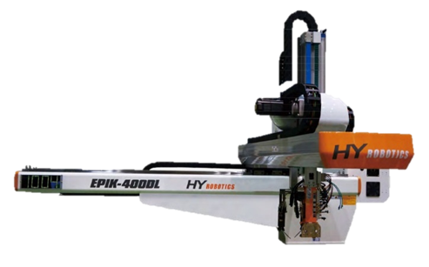
EPIK / UNIK
advanced Training

Slide 2
Advanced Training for those who already have basic knowledge of:
Checking signals – Input / Output / Interlock
Manually move the robot
Teaching 4 (four) basic positions – Waiting / Takeout / Up / Release
Parameter / Delay / Speed settings

Slide 3
1| Custom Programming
INDEX
EPIK / UNIK
advanced Training
Adding Positions
Adding Direct Output / Pulse command
Adding Delay time
Adding Wait Input signal command
2| Connecting USB Thumb drive
3| Hidden Menus in Lv. 16 Administrator

Slide 4
1 | Custom programming
Adding Positions
Adding Direct Output / Pulse command
Adding Delay time
Adding Wait Input signal command
Notes:
This is for More complex task beyond simple take out pick & place task.
More positions to move, adding out put command to 2ndary devices such as gate cutters, vision sensor, or sticker dispenser.

Slide 5
z
Custom Programming
User Log in
Lv. 16 Administrator (Password: pass)
Lv. 7 Teacher (Password: teacher)
Lv. 1 Operator (Password: operator)
To access entire systems in controller
To access the basic settings and programs
To control the robot operation in auto or manual

Slide 6
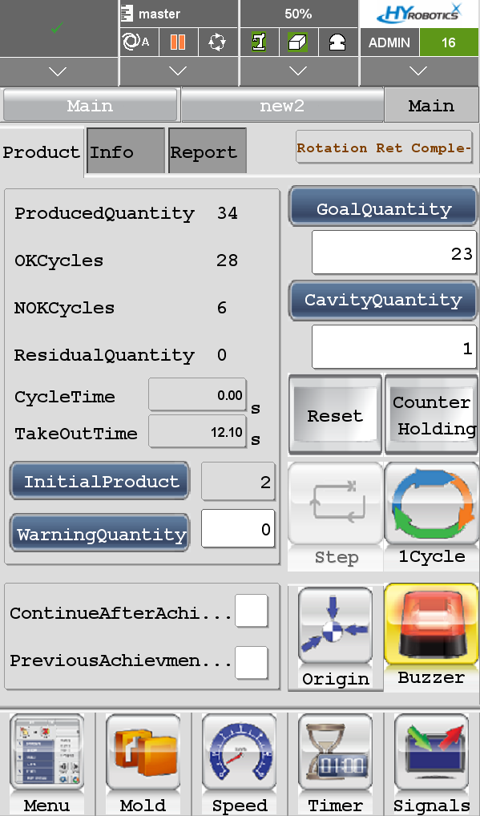
z
Custom Programming
Programming
screen

Slide 7
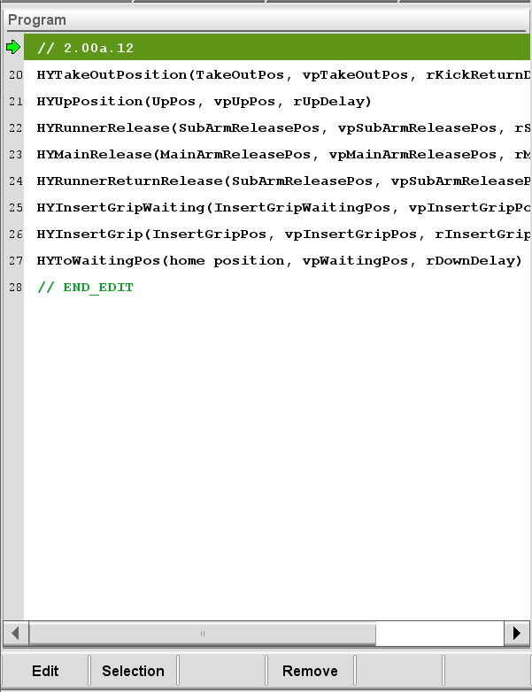
z
Custom Programming
Programming
screen

Slide 8
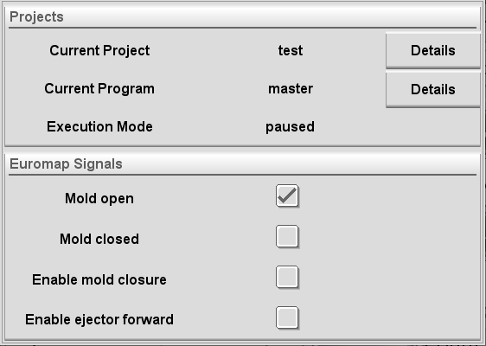
z
Custom Programming
HYROBOTICS CORP
5319 Brown Ave.
St. Louis MO, 63120, USA
http://www.hyrobotics.com

Slide 9
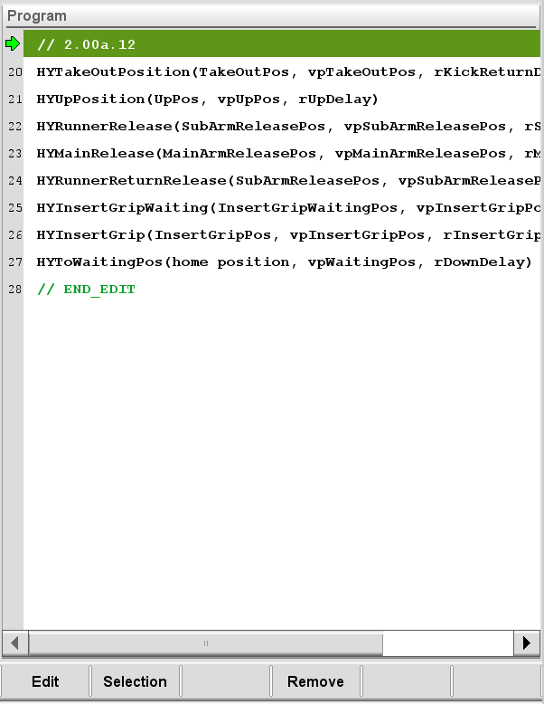
z
Custom Programming

Slide 10
z
Custom Programming

Slide 11
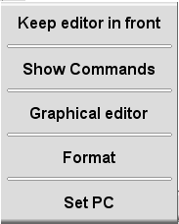
z
Custom Programming

Slide 12
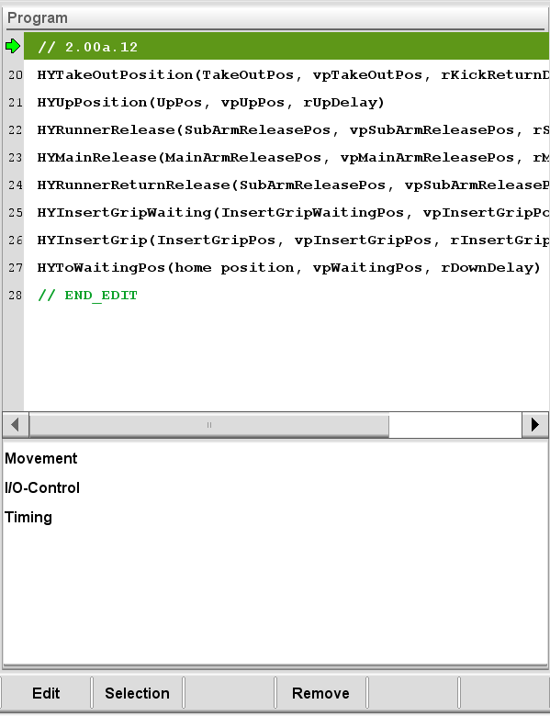
z
Custom Programming
Program Lines
commands
Notes:
More commands will appear with high log in level.

Slide 13
z
Custom Programming
lv. 7 Commands
Movement
Move HY
I/O Control
Set DO
Pulse DO
Timing
Wait Time Sec
Wait D IN
Notes:
More commands will appear with high log in level.

Slide 14
Adding positions
Movement
Move HY

Slide 15
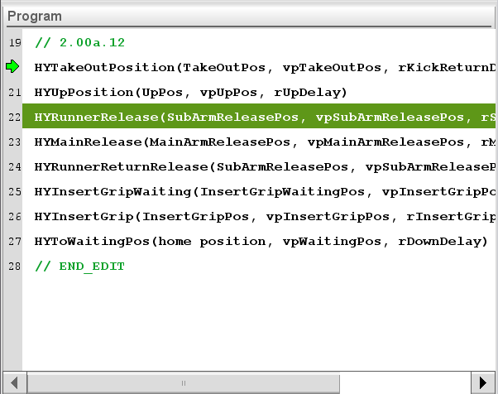
z
Custom Programming
Case 1
Adding A Position
after releasing sprue (LINE 22).
Wait 5 seconds before moving.
As soon as reaching, rotate EOAT.
Notes:
New line will be added after the line you selected.

Slide 16
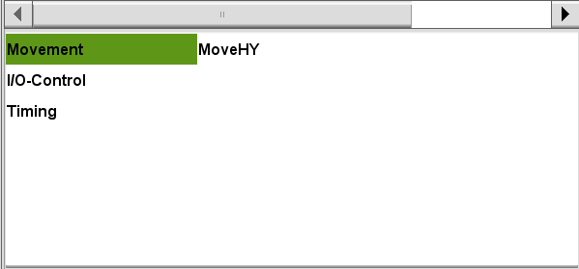
z
Custom Programming
Notes:
More commands will appear with high log in level.

Slide 17
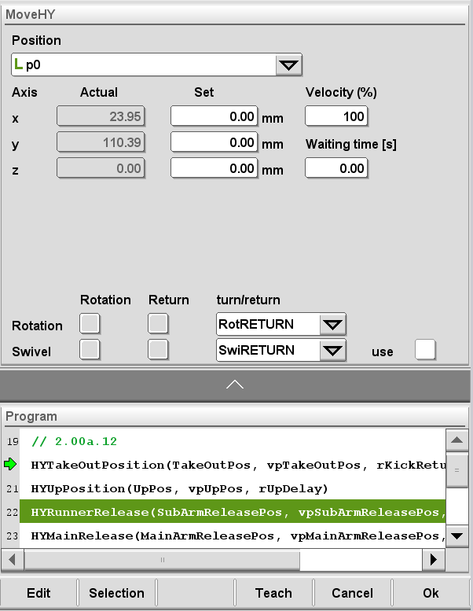
z
Custom Programming
Move the robot manually.
Press “Teach” button
Velocity 100%?
Waiting Time (Delay Time) ?
After reaching this position,
Rotation Return? or Rotation Turn?
Press “OK”
Notes:
Delay Time before moving to this position.

Slide 18
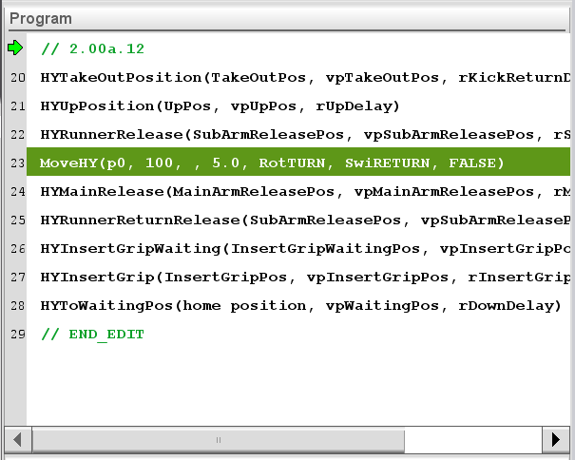
z
Custom Programming
Move to P0
with 100% velocity
after waiting 5 seconds.
Then Turn EOAT.
Case 1
Notes:
decode

Slide 19
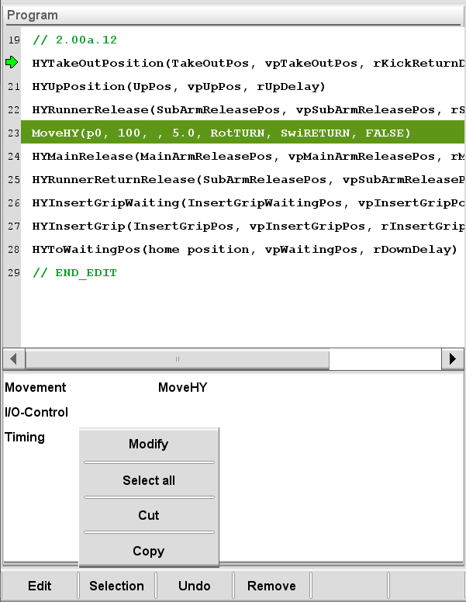
z
Custom Programming
Modify
Cut
Copy
Notes:
Delay Time before moving to this position.

Slide 20
Adding
Direct outputs / Pulse signals
Set DO
Pulse DO
I/O Control
Turn on / off a signal,
and it stays until there is OFF signal command.
Ex) Vacuum, Gripper
Turn on a signal,
and after certain time, it turns OFF.
Ex) Cutter, Vision sensor trigger
Notes:
Turn on / off outputs or signals.
Such as rotation End of Arm, vacuums, and activating gate cutters or triggering vision sensor.

Slide 21
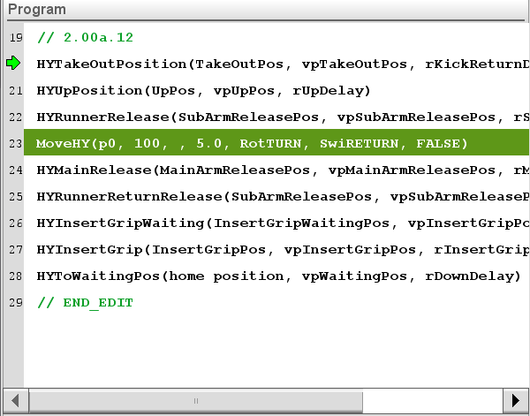
z
Custom Programming
Case 2
After moving to p0,
“PULSE User Output1 ON
for 2sec”
User outputs are located in I/O box of the robot.
Notes:
Delay Time before moving to this position.

Slide 22
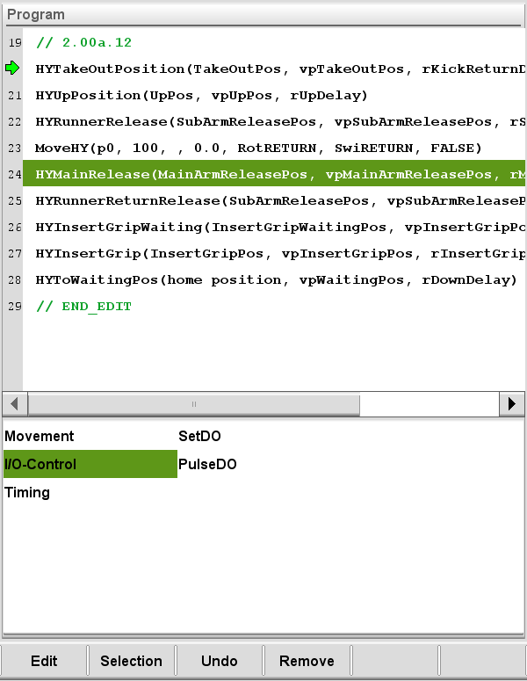
z
Custom Programming
Notes:
Delay Time before moving to this position.

Slide 23
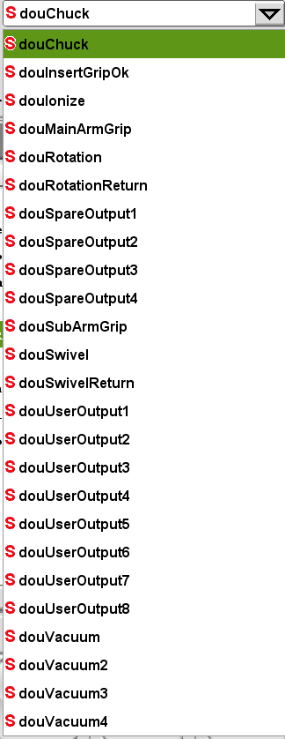
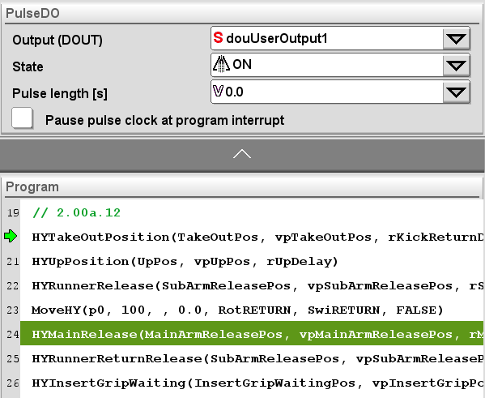
z
Custom Programming
Notes:
Delay Time before moving to this position.

Slide 24
z
Custom Programming
Notes:
Delay Time before moving to this position.

Slide 25
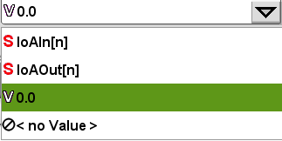
z
Custom Programming
Notes:
Delay Time before moving to this position.

Slide 26
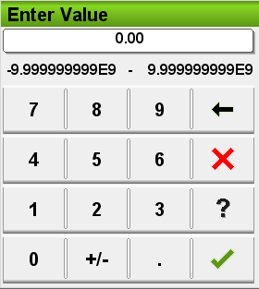
z
Custom Programming
Enter 2, and press “OK”
Notes:
Delay Time before moving to this position.

Slide 27
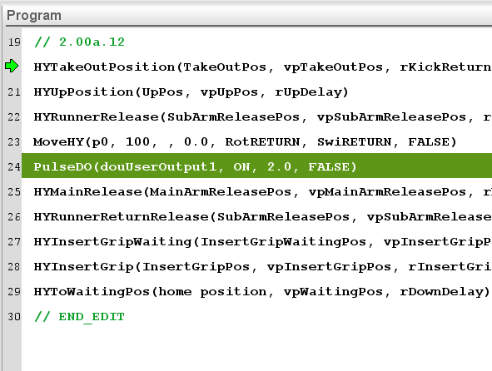
z
Custom Programming
Case 2
User Output1 ON for 2sec

Slide 28
Adding wait time
Timing
Wait Time Sec
Wait D IN
Simply “Wait certain time”, and move on to the next line.
Ex) put delays before proceeding to the next command line.
Stop and “Wait a certain Input signal” to be turned ON or OFF.
Ex) Wait OK signal from a vision sensor to proceed to the next command line.
Notes:
Turn on / off outputs or signals.
Such as rotation End of Arm, vacuums, and activating gate cutters or triggering vision sensor.

Slide 29
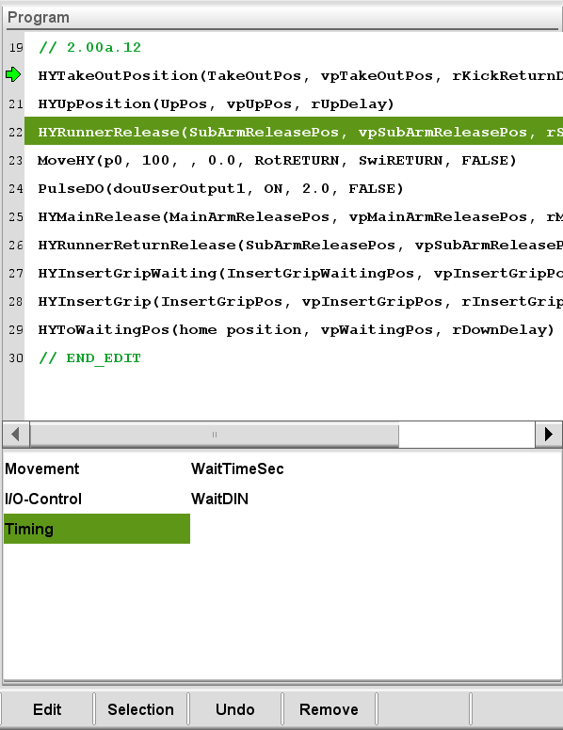
z
Custom Programming
Case 3
Put 2 sec. delay time
before moving to p0

Slide 30
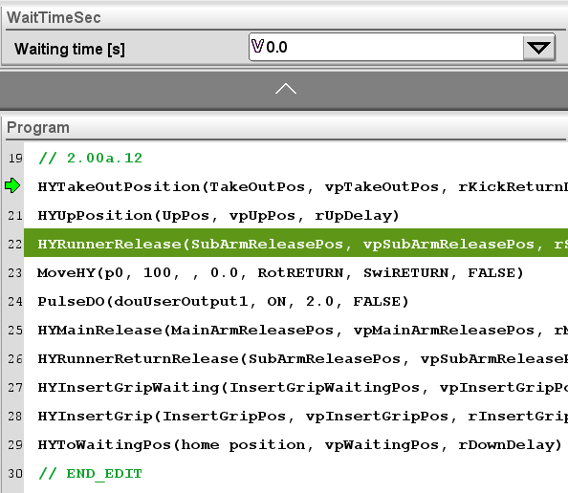
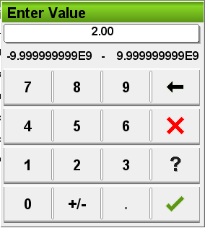
z
Custom Programming

Slide 31
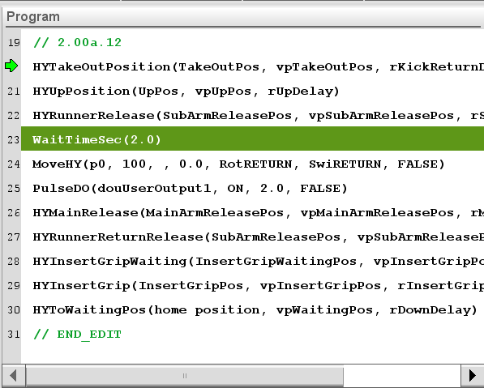
z
Custom Programming
Case 3
Wait Time 2 sec is added

Slide 32
z
Custom Programming
Case 4
Pause the operation &
Wait until “User Input 1 is ON”
After line 25

Slide 33
z
Custom Programming

Slide 34
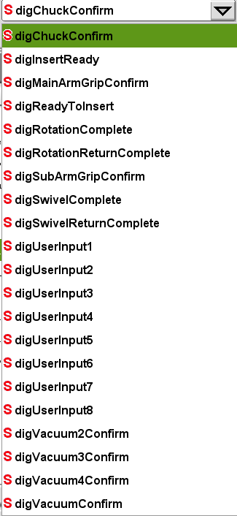
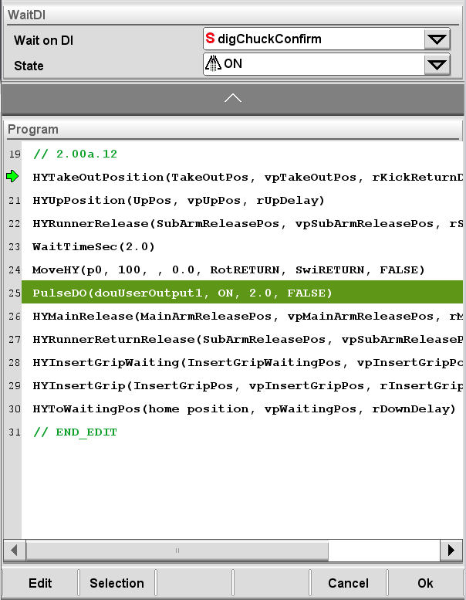
z
Custom Programming

Slide 35
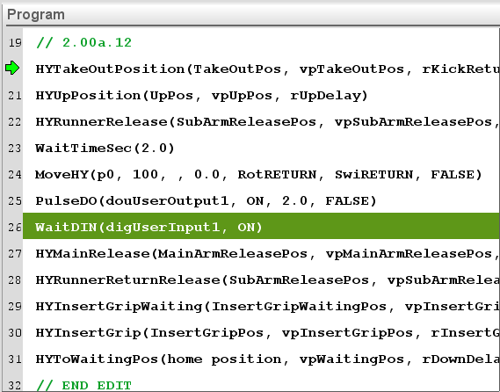
z
Custom Programming
Case 4
Robot stops and
Waits Direct User Input1
to be turned ON

Slide 36
1 | Custom programming
Adding Positions
Adding Direct Output / Pulse command
Adding Delay time
Adding Wait Input signal command
Questions?

Slide 37
2 | Connecting usb thumb drive
Back up / Restore Mold Files
Custom programming with PC

Slide 38
z
Connecting USB Thumb Drive
Log into Lv. 16
Connect USB drive to the teaching pendant.
USB system must be FAT32 type.
NTFS type does not work

Slide 39
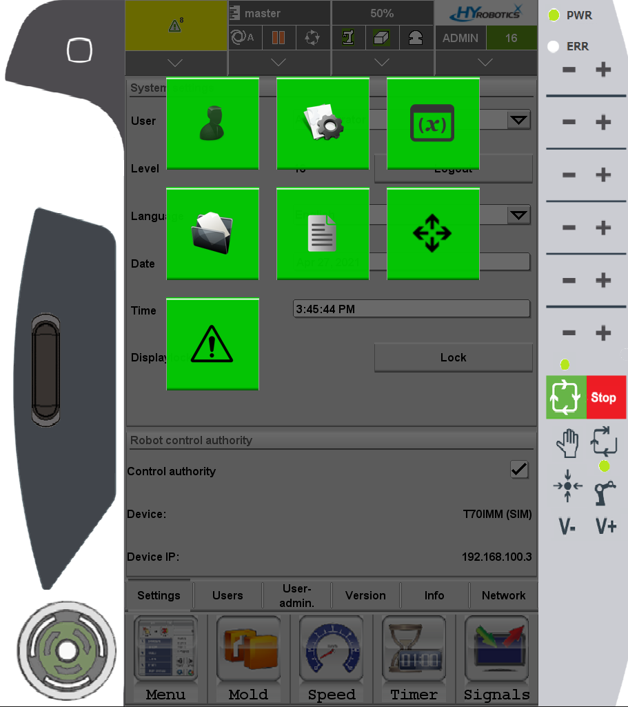
z
Connecting USB Thumb Drive
Double press
Program manager

Slide 40
z
Custom Programming
HYROBOTICS CORP
5319 Brown Ave.
St. Louis MO, 63120, USA
http://www.hyrobotics.com

Slide 41
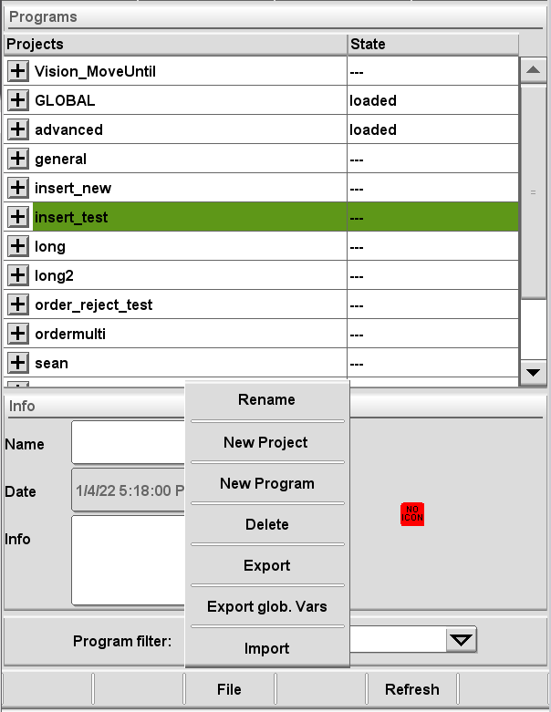
z
Connecting USB Thumb Drive
<Back up>
Select the mold file you want to back up.
Press “FILE” → “Export”
* Currently loaded mold file CANNOT be backed up. If you want to back up current loaded file, press CLOSE button first.

Slide 42
z
Connecting USB Thumb Drive
Select “Ketop”
Back up processing…

Slide 43
z
Connecting USB Thumb Drive
<mold file name> .tt folder is created in USB drive.
Back up completed.

Slide 44
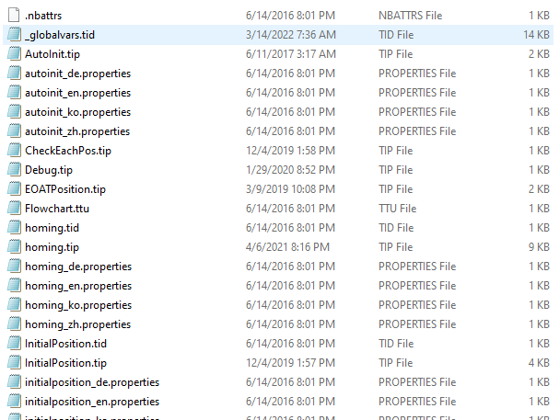
z
Connecting USB Thumb Drive
Over 150 sub-program files
in one (1) mold file folder.

Slide 45
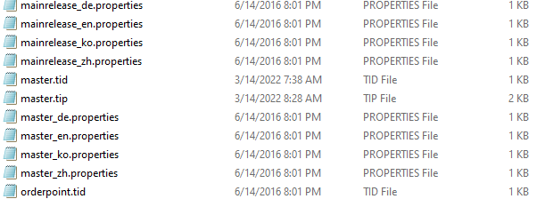
z
Connecting USB Thumb Drive
“MASTER.TIP”
is the main root program.
Open with Notepad® app.

Slide 46
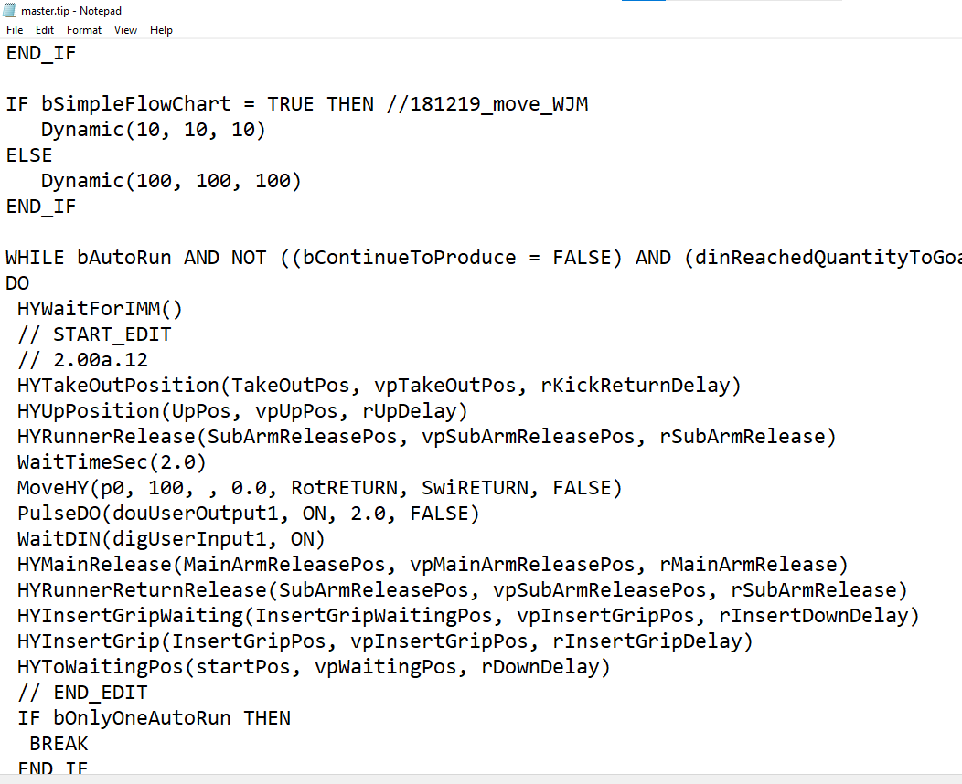
You can edit and save
master program

Slide 47
z
Connecting USB Thumb Drive
<Restoration>
Insert USB drive first.
Press “FILE” → “Import”

Slide 48
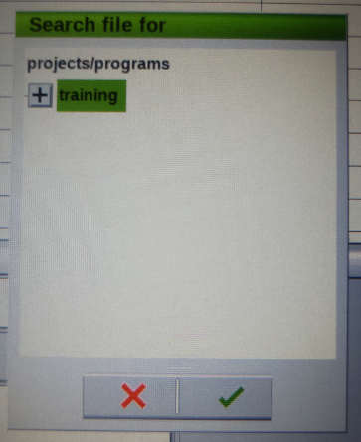
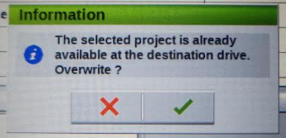
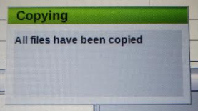
Select Mold file
Overwrite Y/N?
After copying the files,
Restoration will be complete.
Questions?

Slide 49
3 | Hidden menus in lv.16

Slide 50
z
Hidden menus in Lv.16
Double press

Slide 51
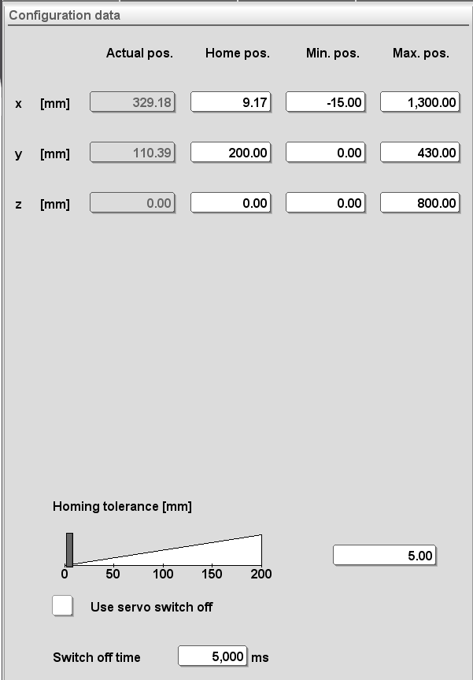
z
Hidden menus in Lv.16
Home Pos = Wait Position
Stroke Limit values

Slide 52
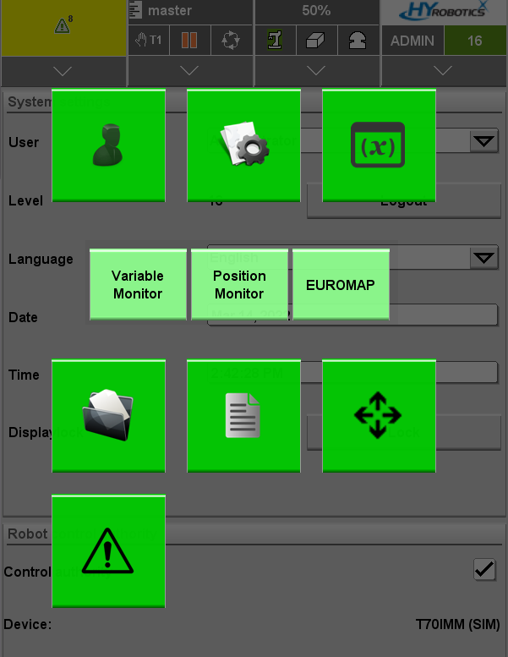
z
Hidden menus in Lv.16
Edit position names
Ex) p0 → Inspection
Check & Edit all position values in one screen.
Jog to positions.
Safety area setting

Slide 53
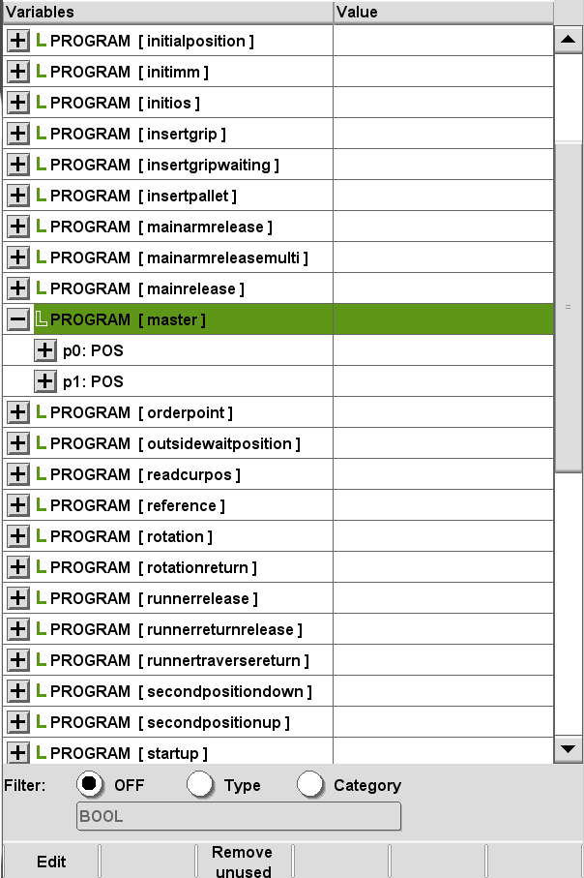
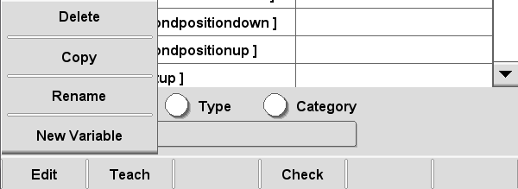
z
Hidden menus in Lv.16
Find “Master”
Press button.
You will see positions you have added
Press “Edit” → “Rename”

Slide 54
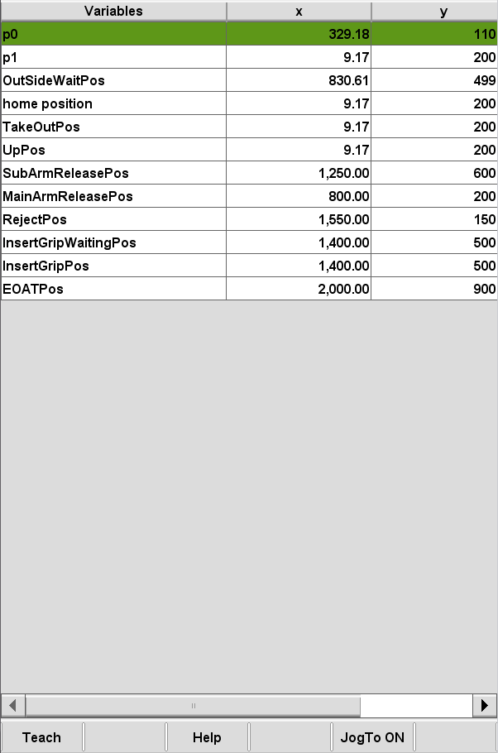
z
Hidden menus in Lv.16
Check position values including added positions
Adjustment available even while operating. *MUST BE VERY CAREFUL

Slide 55
z
Hidden menus in Lv.16
Jog To Positions will be explained
during hand-on training.

Slide 56
thank you

